Slide 1
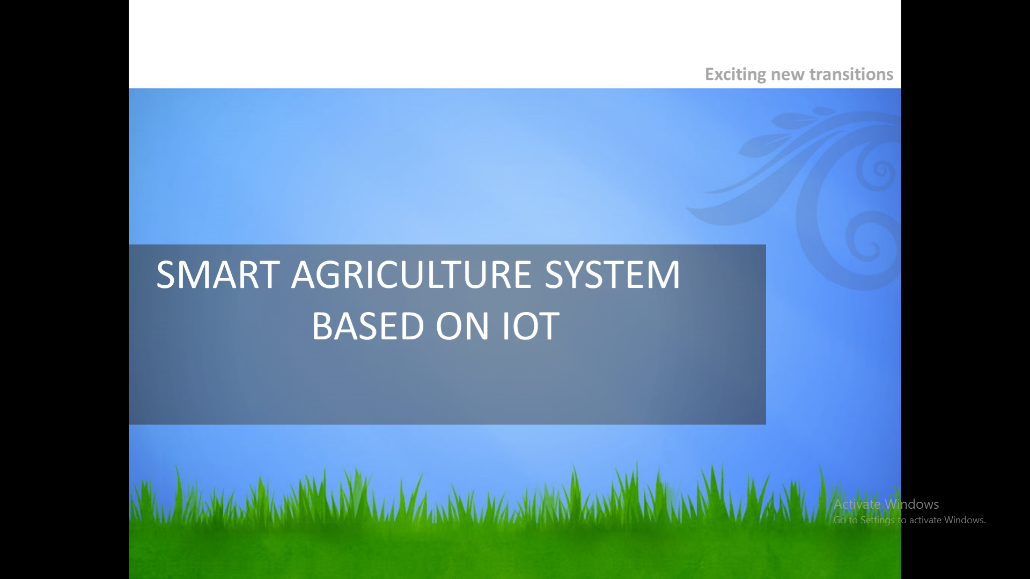
By
M Teja
B-Tech(III-Year)
VNR VJIET, Hyd.

Slide 2
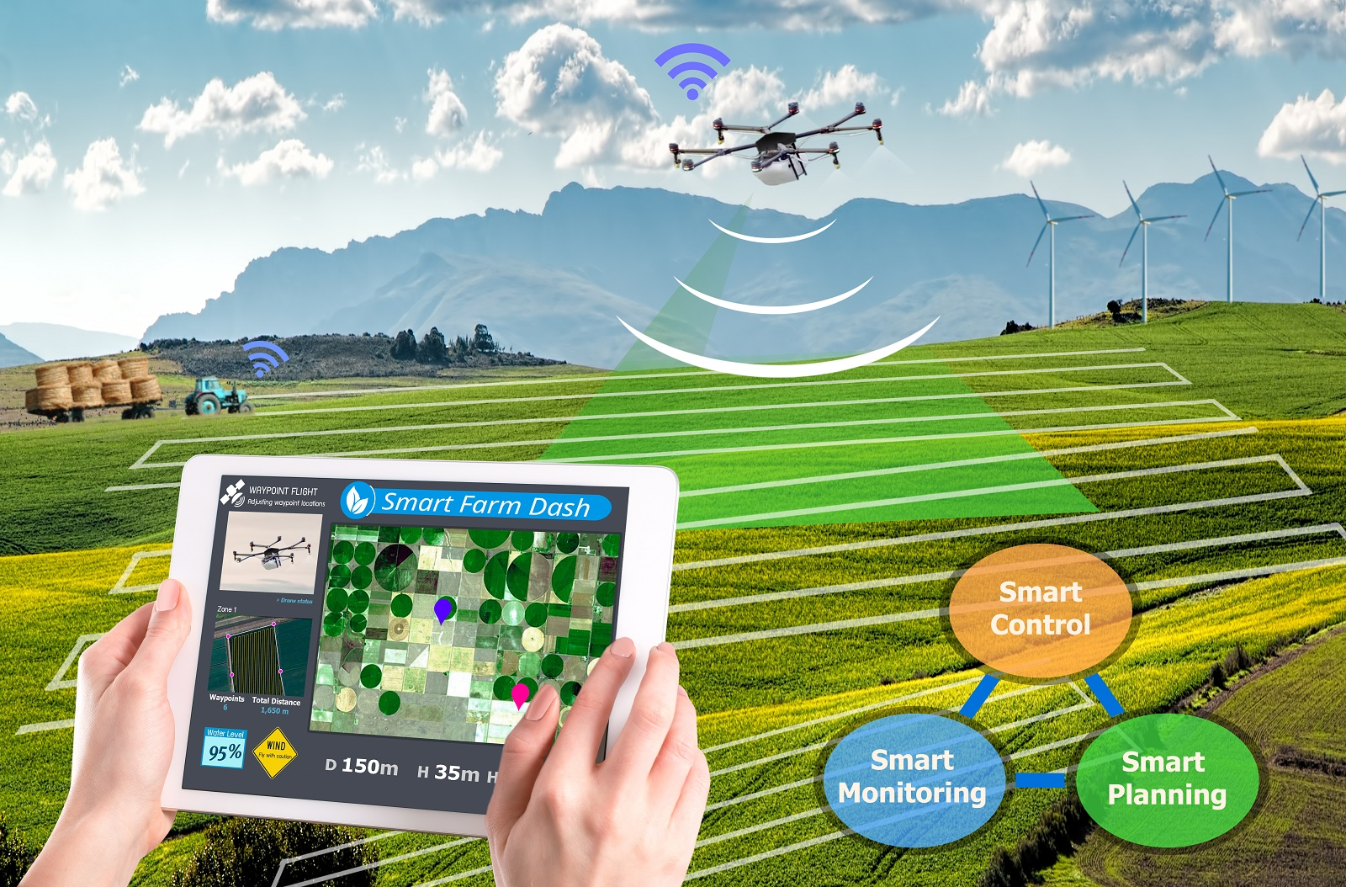
Internet of Things in Agriculture

Slide 3
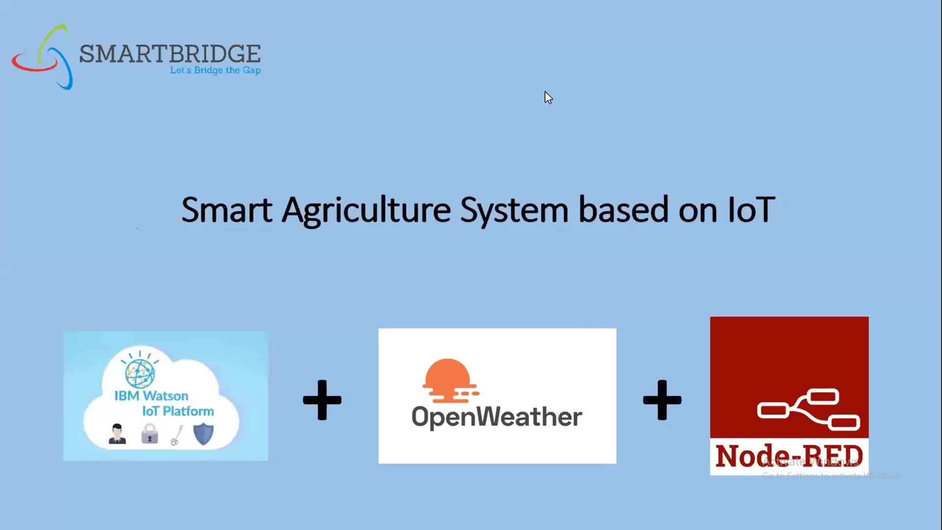
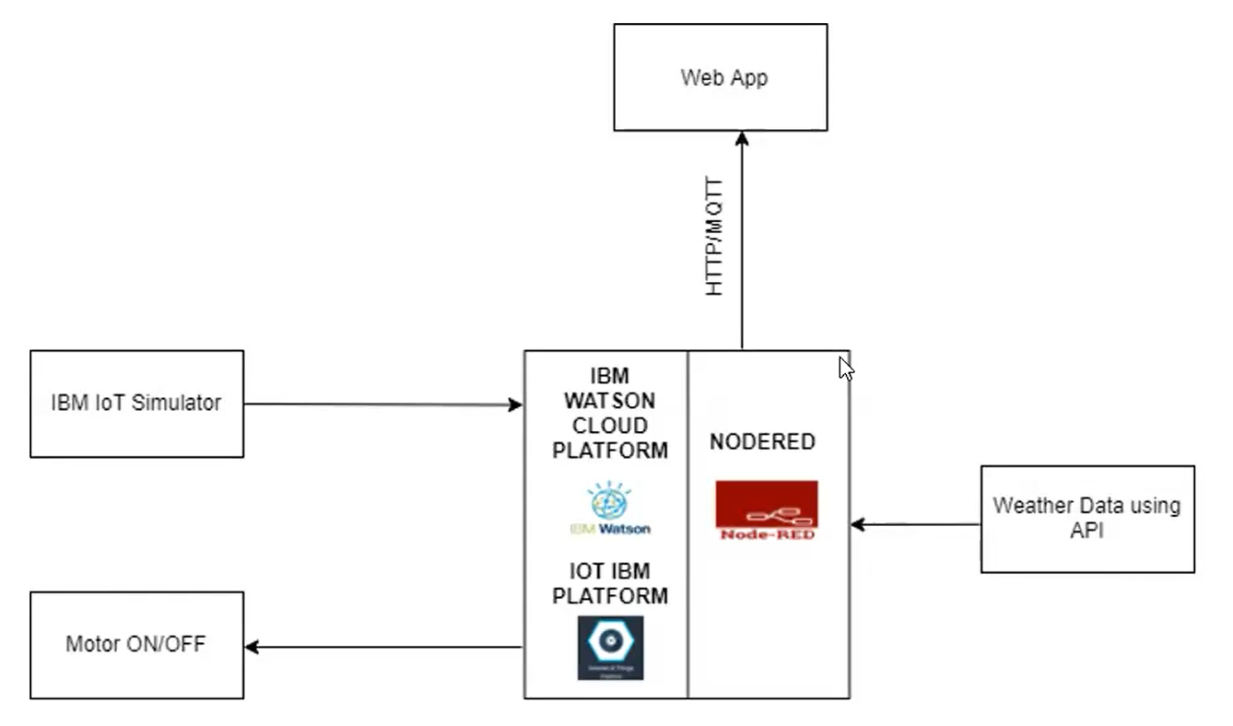

Slide 4
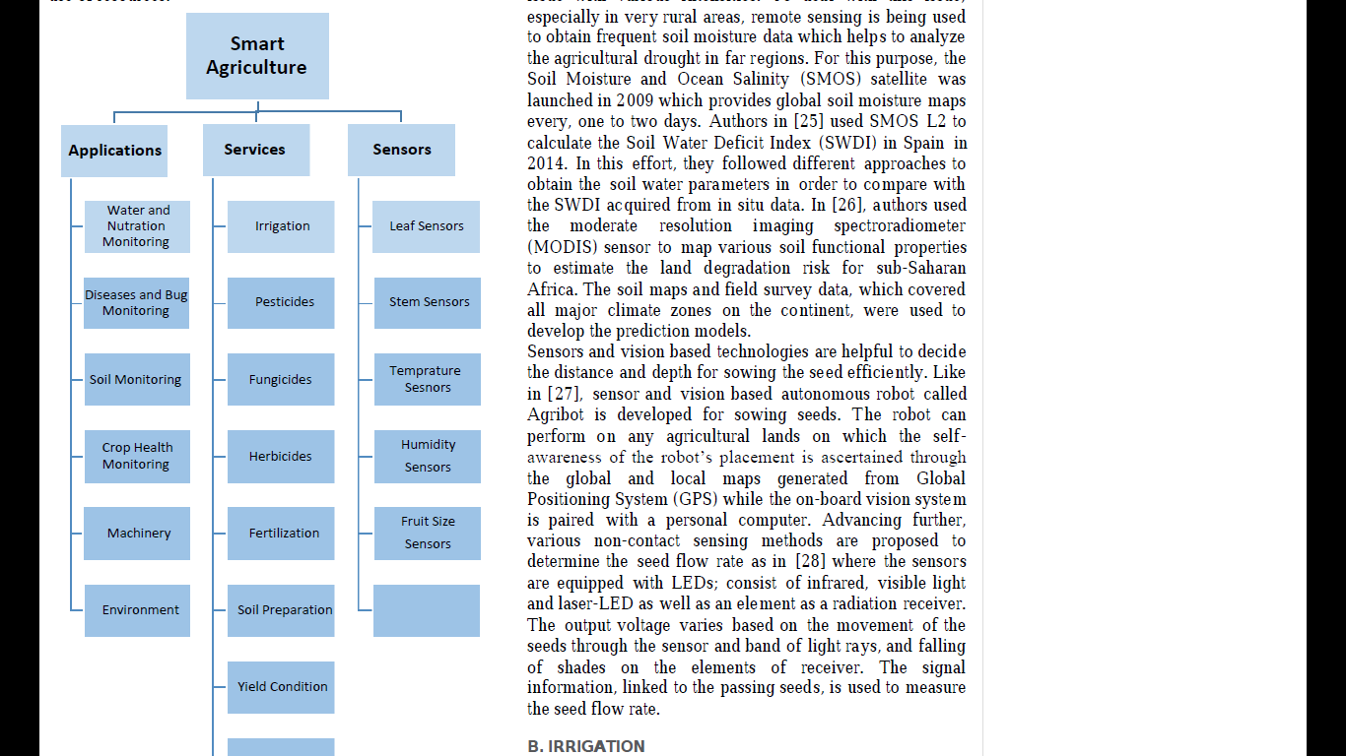
Future Scope
Future work would be focused more on increasing sensors on this system to fetch more data especially with regard to Pest Control and by also integrating GPS module in this system to enhance this Agriculture IoT Technology to full-fledged Agriculture Precision ready product.

